Slide 1






DATASOC X NAB
SUSTAINABILITY REPORT
Quan Hoang
Data Analyst
Linh To
Data Analyst
Quoc Ho
Data Analyst

Slide 2


AGENDA
01
INTRODUCTION
02
AIR POLLUTION ANALYSIS
03
WATER AND WASTE MANAGEMENT
04
LAND COVER ANALYSIS
05
CONCLUSION

Slide 3
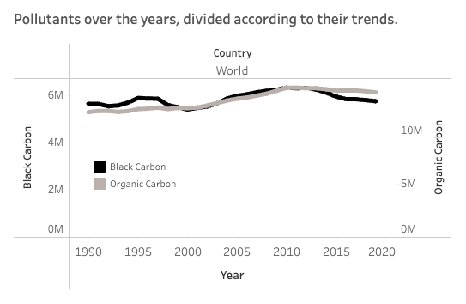
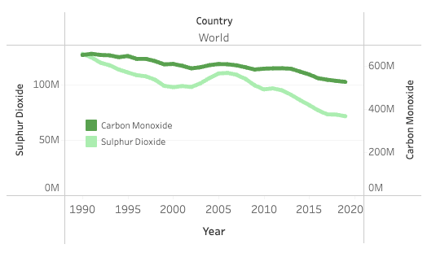
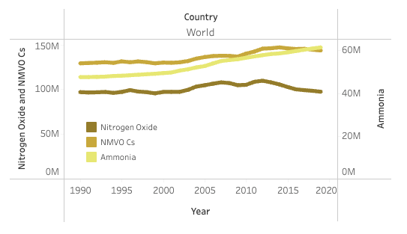


Air Pollution - Pollutants Over Time
Black Carbon and Organic Carbon and Amonia rose
Carbon Monoxide and Sulphur Dioxide experienced significant decrease
Major drop in Sulphur Dioxide might be attributed to shipping traffic and fuel regulations
Agenda
Air Pollution
Waste Management
Water Management
Lane Cover
Strategy

Slide 4
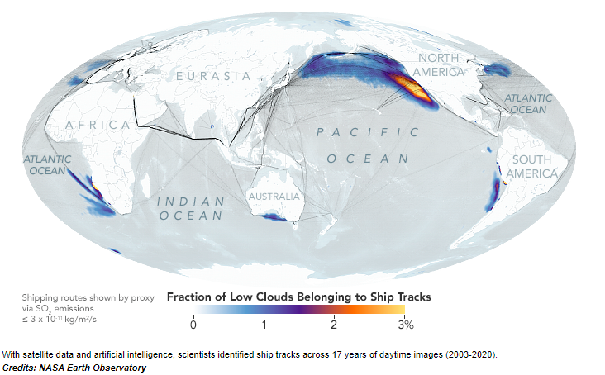
Air Pollution - Pollutants Over Time
https://www.nasa.gov/feature/esnt/2022/nasa-study-finds-evidence-that-fuel-regulation-reduced-air-pollution-from-shipping
Agenda
Air Pollution
Waste Management
Water Management
Lane Cover
Conclusion

Slide 5
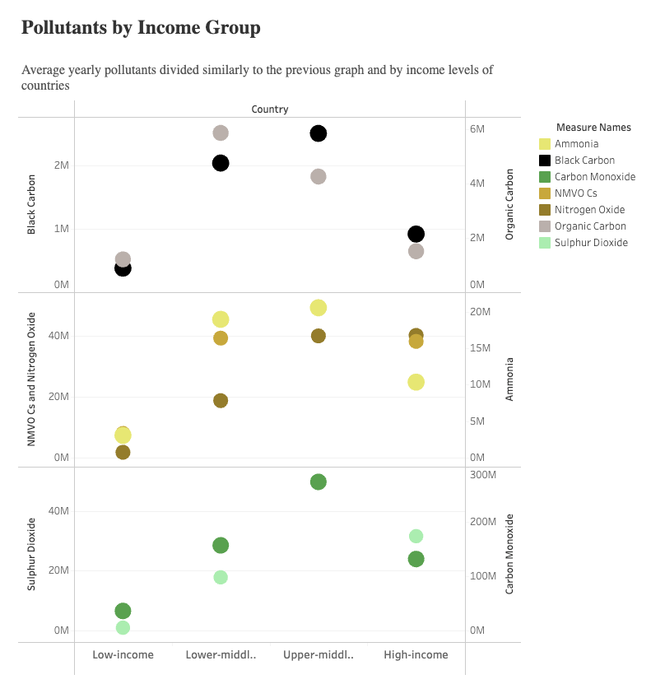
Air Pollution - Pollutants by Income Group
Middle-income and high-income countries emit significant amount of pollutants
Hypothesis: These figures are greatly inflated by only a few countries
Agenda
Air Pollution
Waste Management
Water Management
Lane Cover
Conclusion

Slide 6
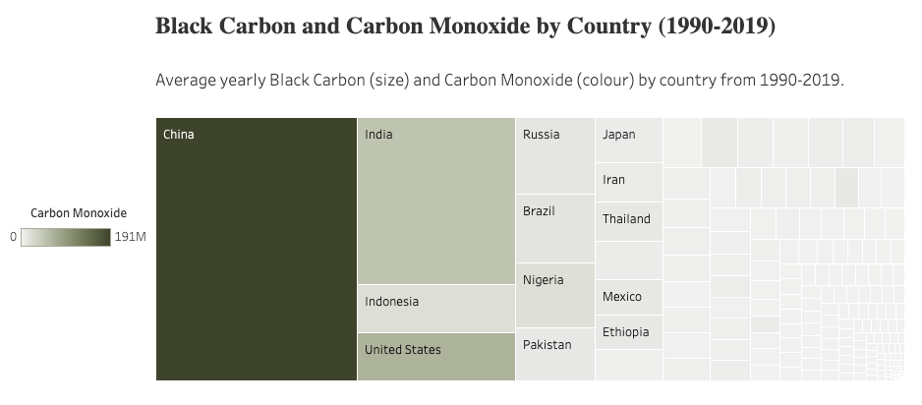


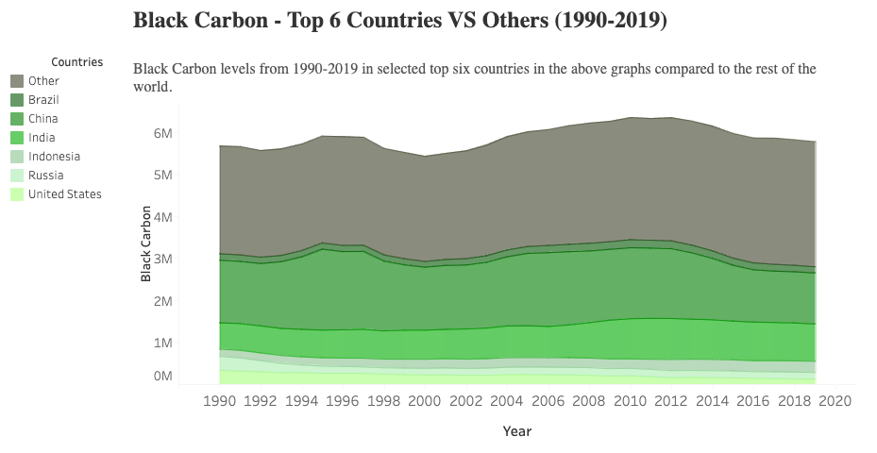
Air Pollution - Pollutants by Countries
Hypothesis: Amount of pollutants by income group are greatly inflated by only a few countries
40% of Black Carbon and Carbon Monoxide were generated by a few countries, including:
High-income: the United States
Upper-middle income: China, Indonesia, Russia and Brazil
Lower-middle income: India
Agenda
Air Pollution
Waste Management
Water Management
Lane Cover
Conclusion

Slide 7



Air Pollution - Strategy
Proposal
Take Sulphur Dioxide as an example
Adopt fuel regulations from successful countries and transition to green fuel
Focus on countries generating highest pollutants
80/20 strategy - if these countries succeeded, the impact would be immense to worldwide
Reduce ash waste in energy generation
Reduce ash waste from combustion processes in energy generation to reduce Black Carbon
Agenda
Air Pollution
Waste Management
Water Management
Lane Cover
Conclusion

Slide 8
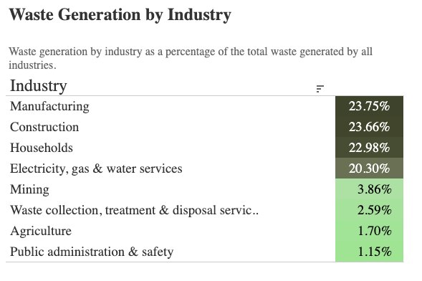
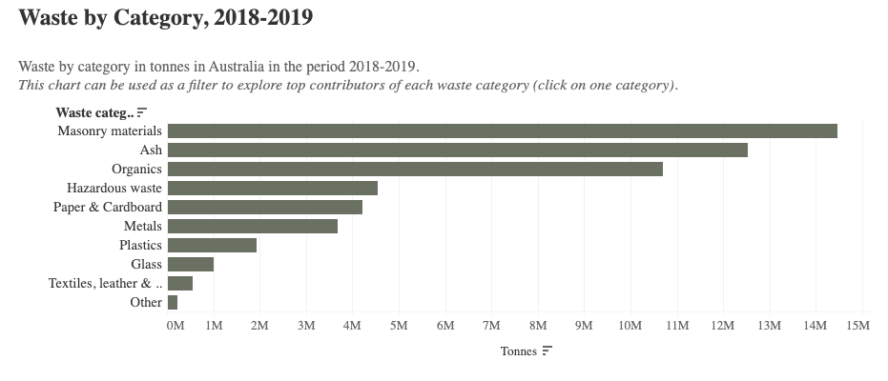
Waste Generation by Industry and Category
Manufacturing, Construction, Households, and Electricity, Gas, and Water Services (Energy/Water Services) generated the most waste in Australia
Top waste categories in 2018-19:
Masonry materials from Construction and Manufacturing
Ash from Energy/Water Services, Organics from Households
Hazardous waste from Manufacturing and Construction
Agenda
Air Pollution
Waste Management
Water Management
Lane Cover
Conclusion

Slide 9
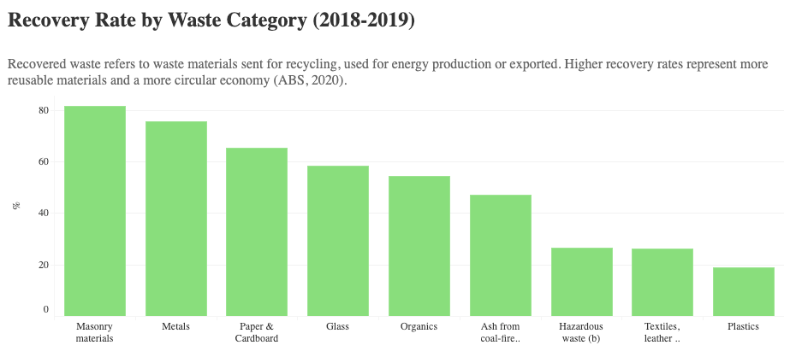

Recovery Rate by Waste Category
Masonry materials, Metals, Paper & Cardboard, Glass, and Organics
50%
Ash, Hazardous waste, Textiles, leather & rubber, and Plastics are high volume - low recovery rate
Agenda
Air Pollution
Waste Management
Water Management
Lane Cover
Conclusion

Slide 10
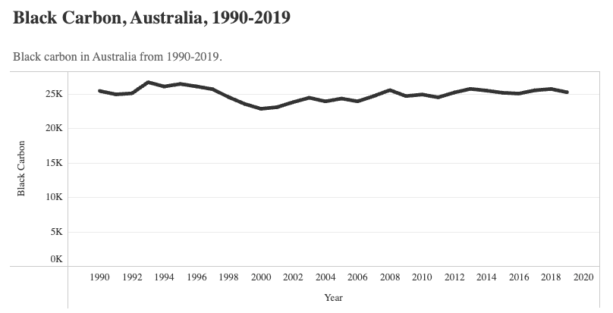
Ash Waste VS Air Pollution
Ash is Australian's 2nd largest waste and has low recovery rate.
Ash is also an important source of Black Carbon in the environment.
Similar efforts in controlling ash may directly lead to reduced air pollution
Agenda
Air Pollution
Waste Management
Water Management
Lane Cover
Conclusion

Slide 11
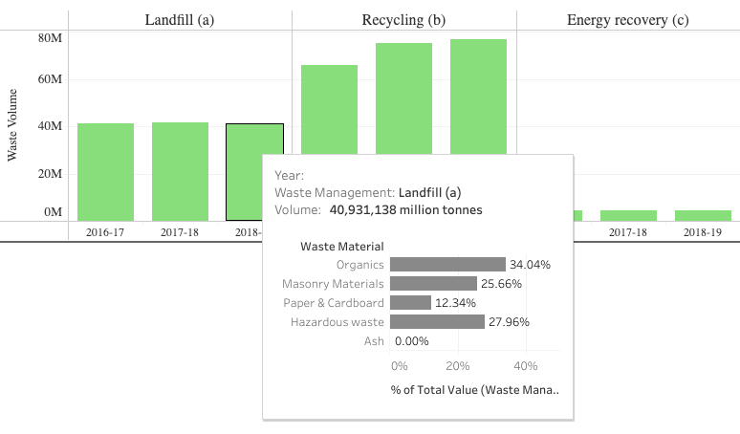
Waste Management
Waste Management 2016-2019
Waste that could not be recycled, used for energy production or exported will be sent to landfill for disposal only
Majority of Landfill waste is Organics, Hazardous waste and Masonry materials
Hazardous waste causes serious problems to the surface and groundwater
Agenda
Air Pollution
Waste Management
Water Management
Lane Cover
Conclusion

Slide 12



Waste Sustainability
Proposal
Focus on high volume-low recovery waste
Focus on waste categories that have high volumes but low recovery rates: Ash, Organics, and Hazardous waste.
Organics waste management
Promote composting to turn organic materials into nutrient-rich compost
Reduce food waste
Reduce ash waste in energy generation
Standardized chemical and physical treatment, to reduce ash from the combustion process in energy generation
Agenda
Air Pollution
Waste Management
Water Management
Lane Cover
Conclusion

Slide 13
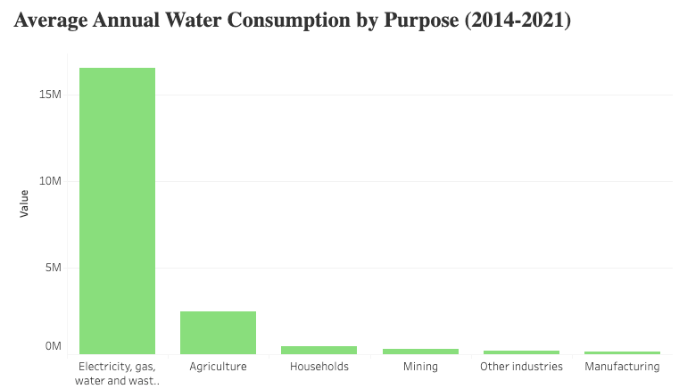
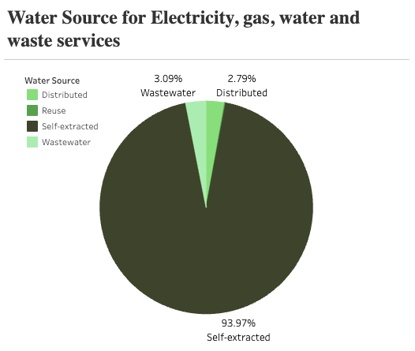
Water Consumption
Electricity, gas, water and waste services have the highest water consumption
Of which 94% is self-extracted water (water directly extracted from the environment)
Agenda
Air Pollution
Waste Management
Water Management
Lane Cover
Conclusion

Slide 14
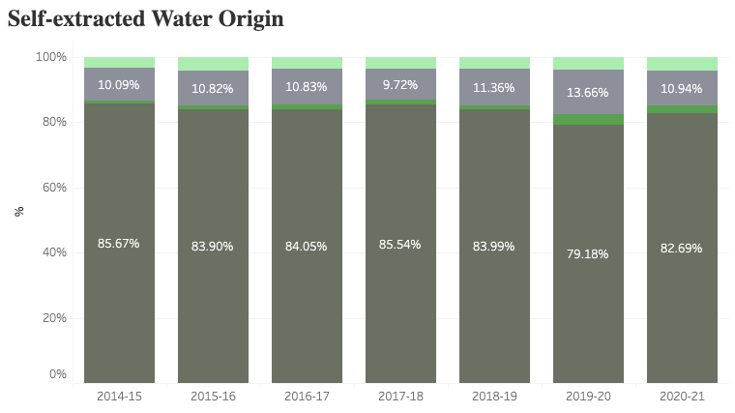
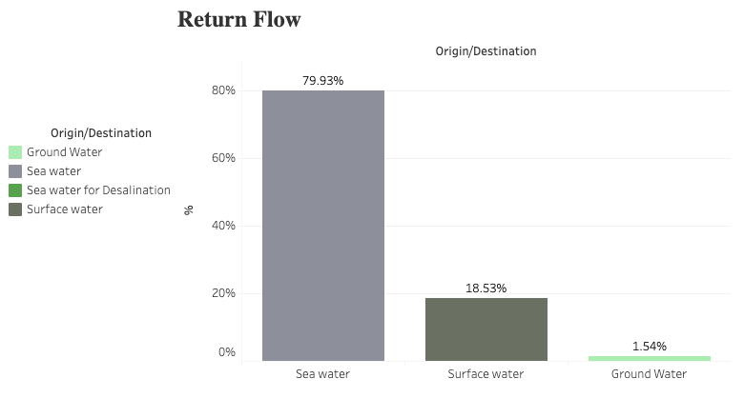
Water Origin and Return Flow
Imbalanced water source
Limited and unpredicted rainfall
Water consumption is expected to rise by 73% in next 30 years, highest pressure on big cities
Without strategies, Australia is likely to suffer from water stress and scarcity
Return flow: water discharged from economic units
In 2020-21, used water was mostly discharged back to the ocean
Might include pollutants and untreated wastewater that harm the environment
Agenda
Air Pollution
Waste Management
Water Management
Lane Cover
Conclusion

Slide 15


Water Sustainability
Proposal
Diversify water sources
Promote the implementation of water recycling and reuse systems in industries, agriculture and urban settings
Encourage the use of desalination plants in regions facing severe water scarcity
Enhance treatment of wastewater
Avoid harming marine ecosystems and coastal water quality when discharging to the ocean
Agenda
Air Pollution
Waste Management
Water Management
Lane Cover
Conclusion

Slide 16
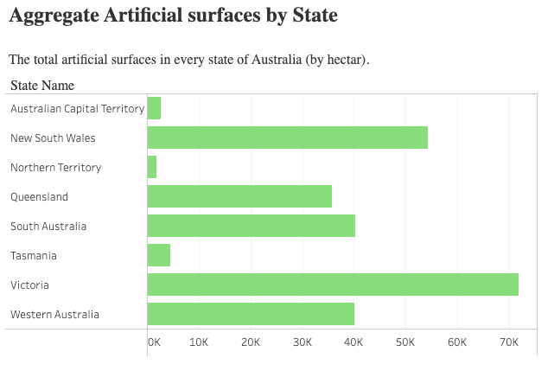
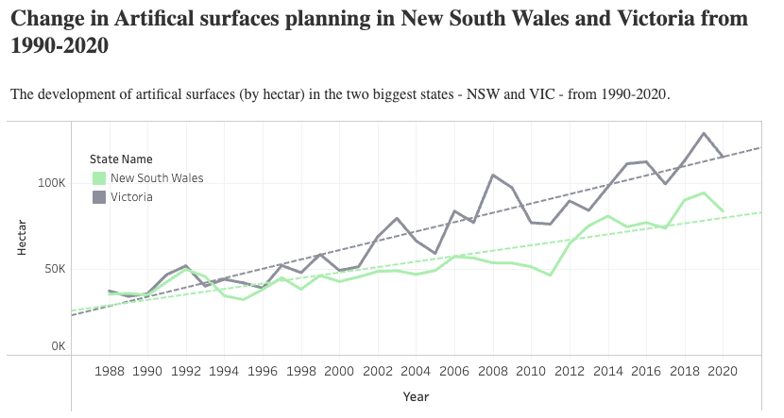
Lane Cover
Artificial surfaces are considerably prevalent in populated states, especially New South Wales and Victoria
These areas have also been increasing over the period of 1990-2020
Agenda
Air Pollution
Waste Management
Water Management
Lane Cover
Conclusion

Slide 17
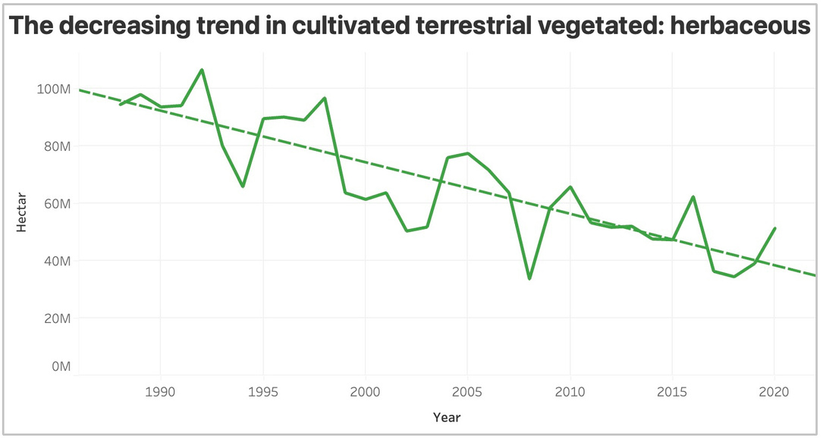
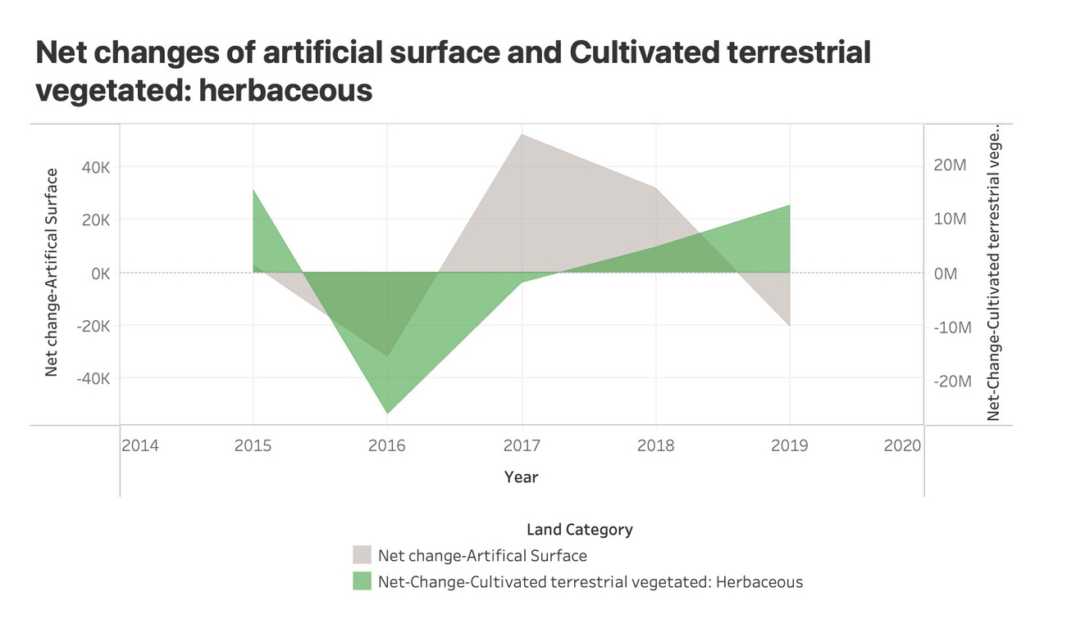
Lane Cover
Cultivated terrestrial vegetated: Herbaceous shows an inverse relationship to the change in Artificial surface
This trend implies a warning sign for the environment and wildlife

Slide 18
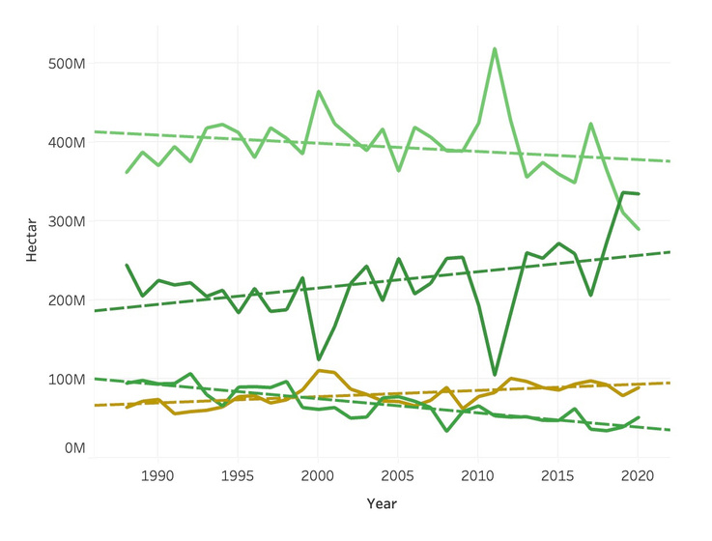
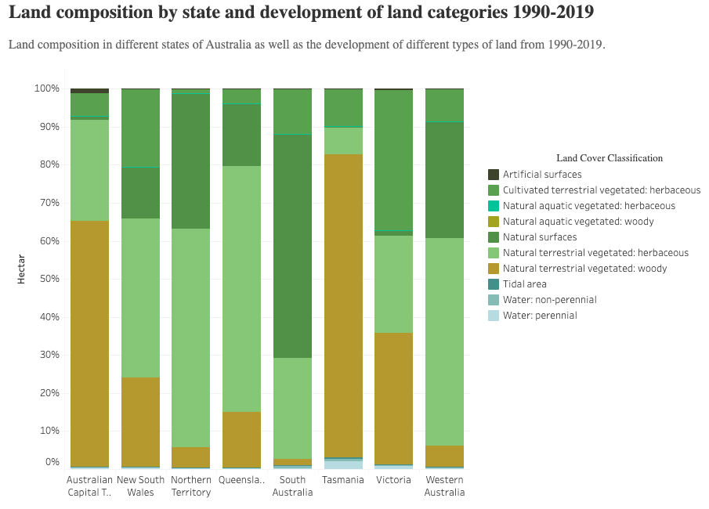
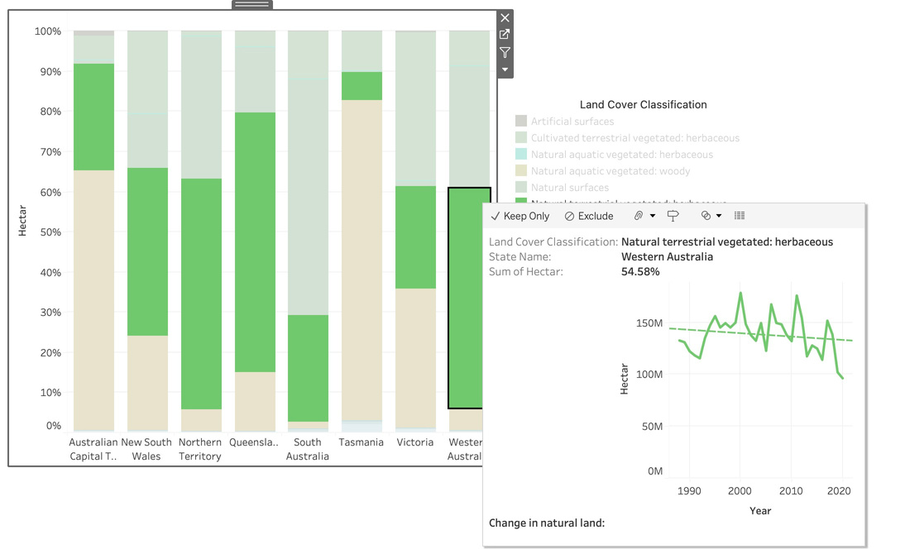
Lane Cover
Natural Surfaces still account for the largest proportion for most states
Natural land has remained almost unchanged or changed slightly from 1998 to 2020
Agenda
Air Pollution
Waste Management
Water Management
Lane Cover
Conclusion

Slide 19
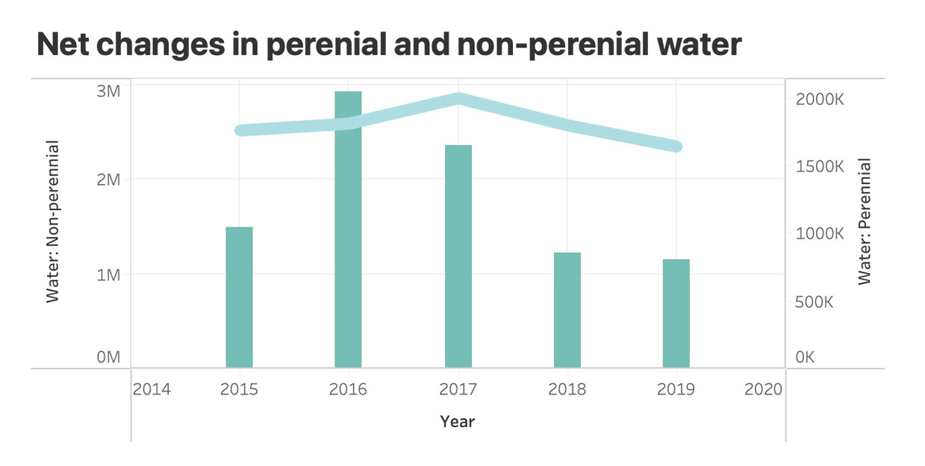
Lane Cover- Perenial & Non-perenial Water
Perennial water bodies provide significant ecosystem services, such as habitat, water purification, flood control, and recreation.
Non-perennial water, such as seasonal wetlands or floodplains, have high ecological value despite their periodic dryness. These lands often serve as important habitats for migratory species and help maintain regional biodiversity.
Land planning should incorporate these services into decision-making, recognizing the economic and social value they provide.
Agenda
Air Pollution
Waste Management
Water Management
Lane Cover
Conclusion

Slide 20
Lane Cover- Strategy
Researching the green materials of artificial surface that is the least likely to impact the environment.
Effective land planning practices, and weigh its pros and cons considerably before executing it.
Implement thorough predictions and management of perennial and non-perennial waters as they are crucial for natural surface, and cultivation practices.
Implement water-saving technologies and practices in agriculture and other industries to reduce the strain on water resources.
Conduct cleanup and restoration projects in areas that have been polluted or degraded by artificial surfaces. This may involve removing contaminants, adding clean soil, and planting native species.
Use non-perennial water bodies for irrigation only during periods of high water availability, ensuring enough water is left to support local ecosystems.
Agenda
Air Pollution
Waste Management
Water Management
Lane Cover
Conclusion

Slide 21

Thank you for listening!
Our Tableau dashboard!

